Slide 1


Slide 2
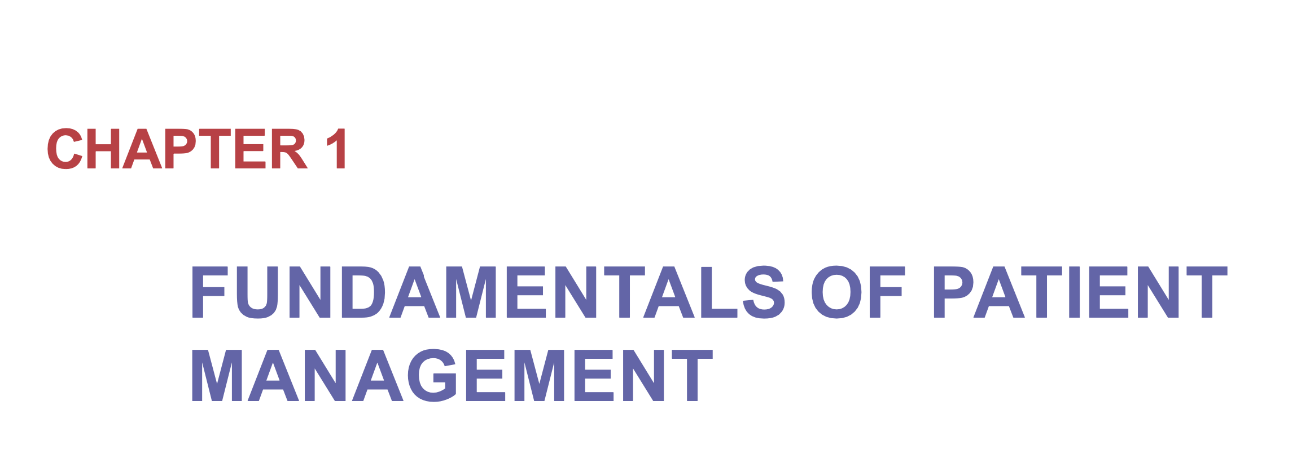
Ali Bagheri M.D
Assistant Professor in Radiation Oncology
Director of Brachytherapy Services at Ahvaz Golestan Hospital
Radiation Oncology Department
Ahvaz Jundishapur University of Medical Sciences

Slide 3

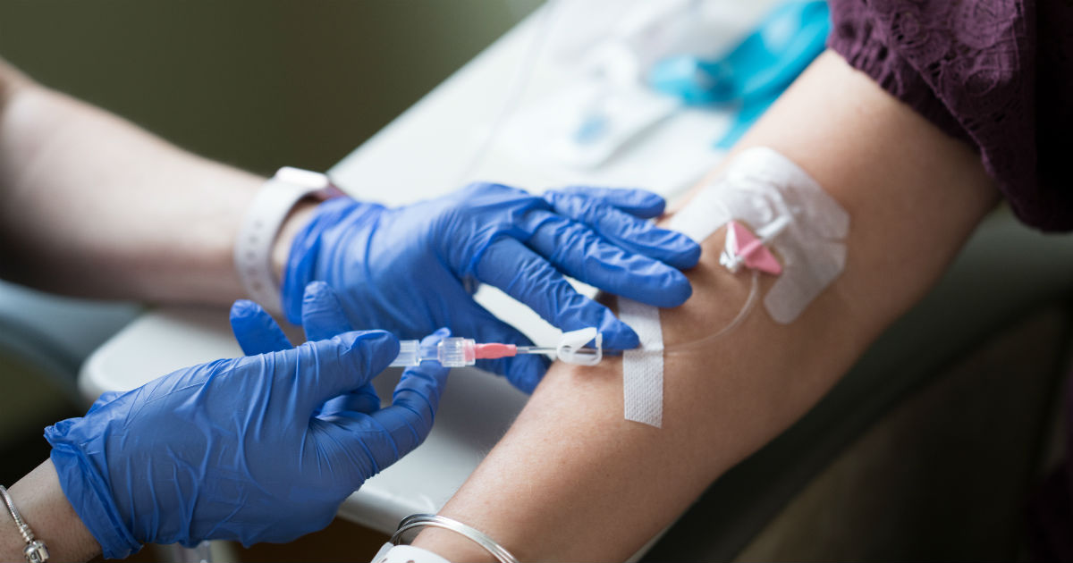
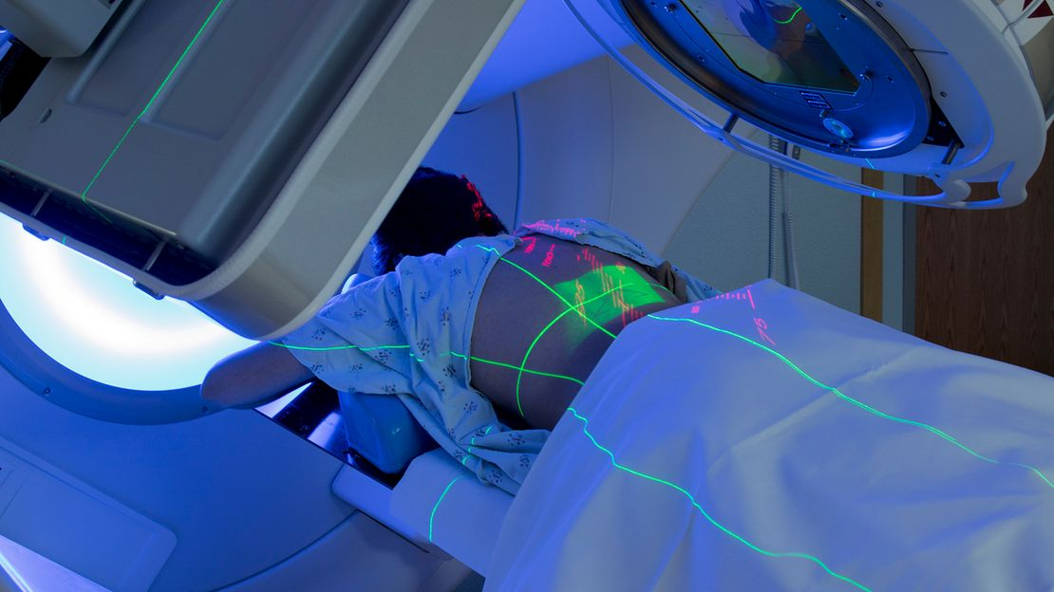
MANAGEMENT OF THE PATIENT WITH CANCER
Surgery
Chemotherapy
Radiation Therapy

Slide 4
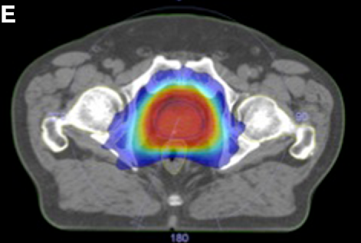
The aim of radiation therapy is to deliver a precisely measured dose of radiation to a defined tumor volume with minimal damage to surrounding healthy tissue.

Slide 5
GOAL OF THERAPY
Cure
Palliation
There is a probability of long-term survival after adequate therapy;
Some side effects of therapy, although undesirable, may be acceptable.
There is little hope of survival for extended periods.
Symptoms producing discomfort or an impending condition that may impair comfort or self-sufficiency require treatment.

Slide 6
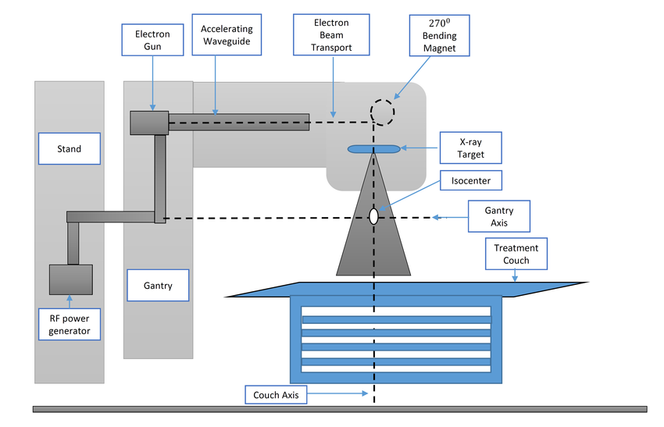
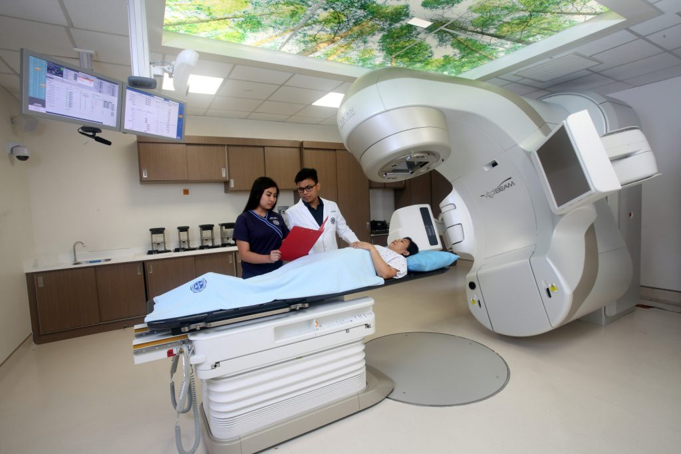
Linear Accelarator (LINAC)

Slide 7
Prescribed Radiation Dose
Tumor extent (stage)
Pathologic characteristics of tumor
Goal of therapy (cure or palliation)
Irradiation alone or combined with surgery, chemotherapy, or both
Nearby organs at risk (OARs)

Slide 8
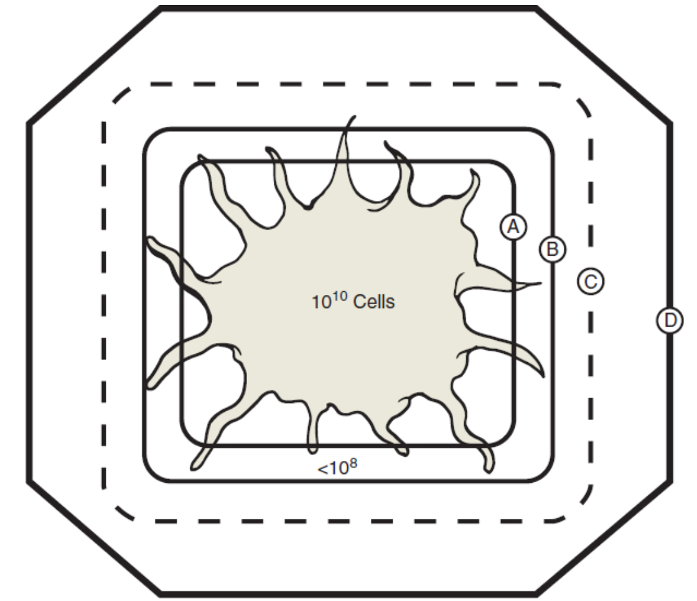
Treatment Volumes
Field Border
PTV
CTV
Gross tumor volume (GTV)
Clinical target volume (CTV)
Planning target volume (PTV)
GTV

Slide 9
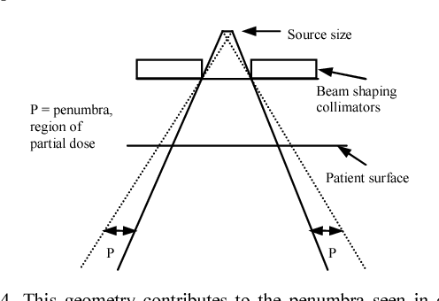
Beam Pnumbra

Slide 10
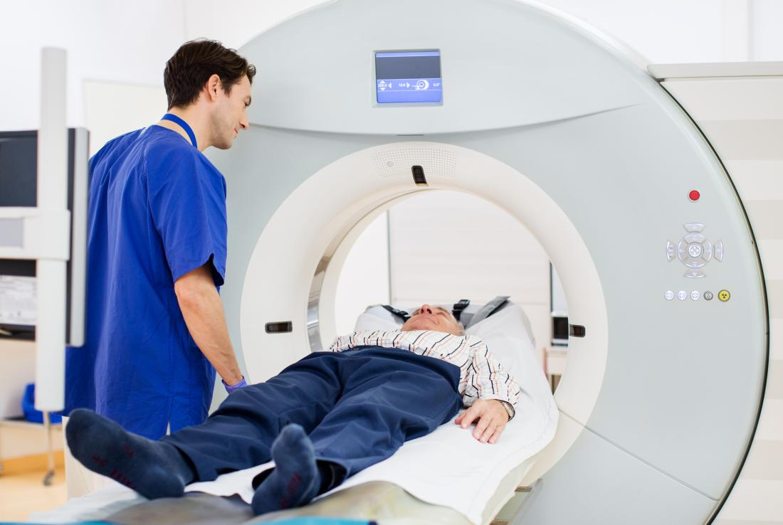
Simulation
Simulation is used to accurately identify target volumes and sensitive structures and to document configuration of portals and target volume to be irradiated.

Slide 11
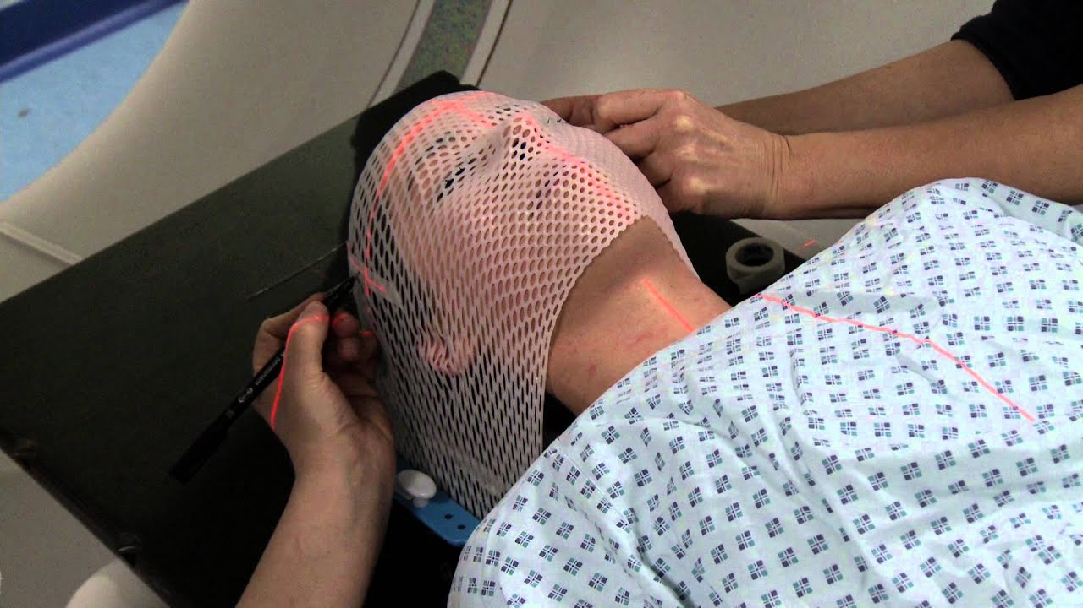

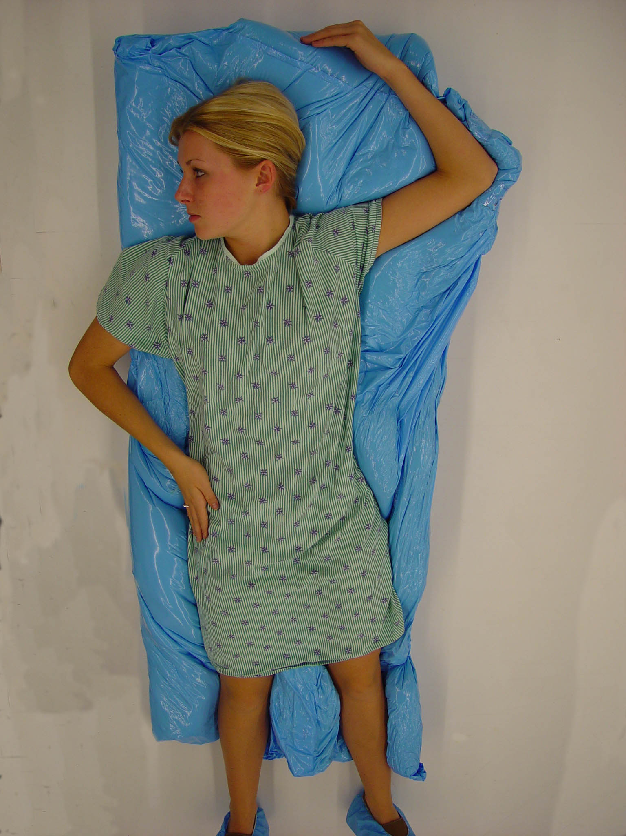
Treatment Aids
Molds
Masks
Shielding blocks

Slide 12
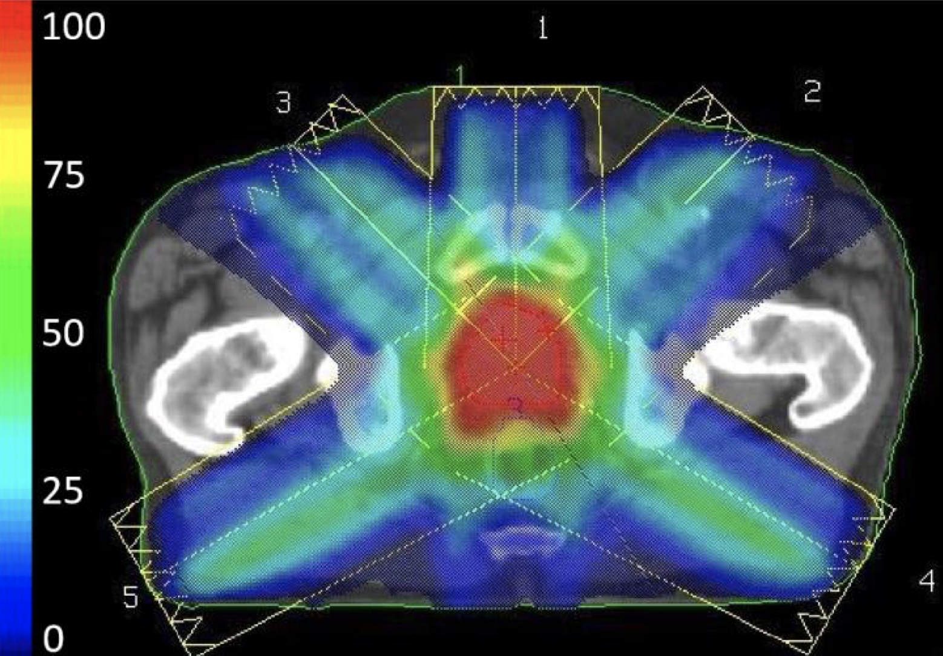
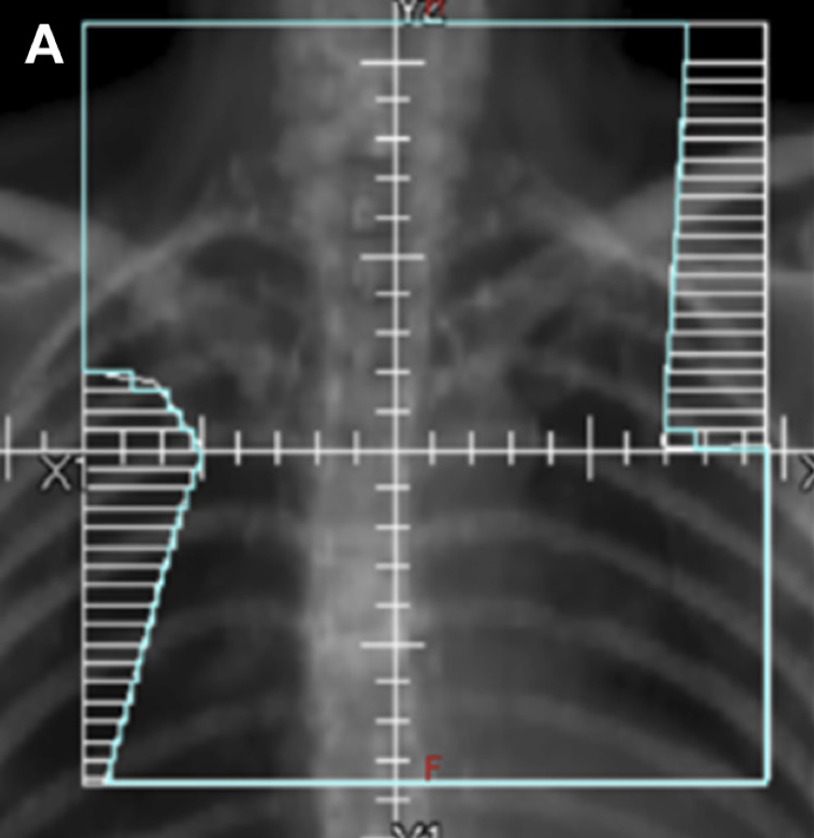
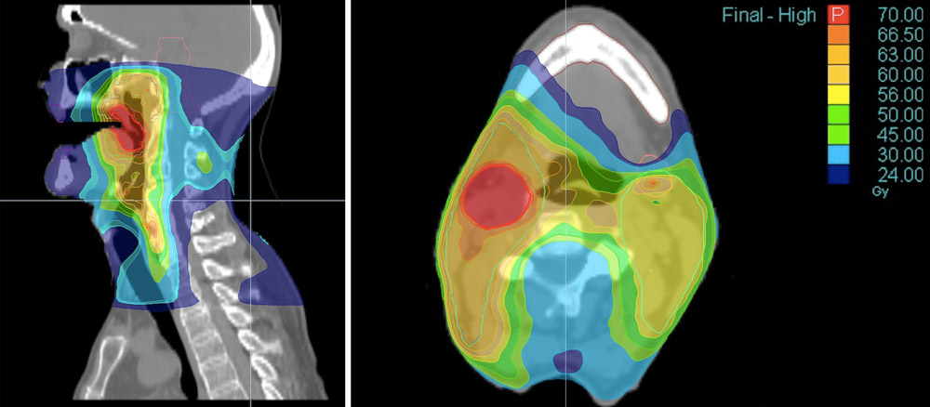
Treatment Planning
3D Conformal Radiation Therapy (3DCRT)
2D
Intensity-Modulated Radiation Therapy (IMRT)

Slide 13
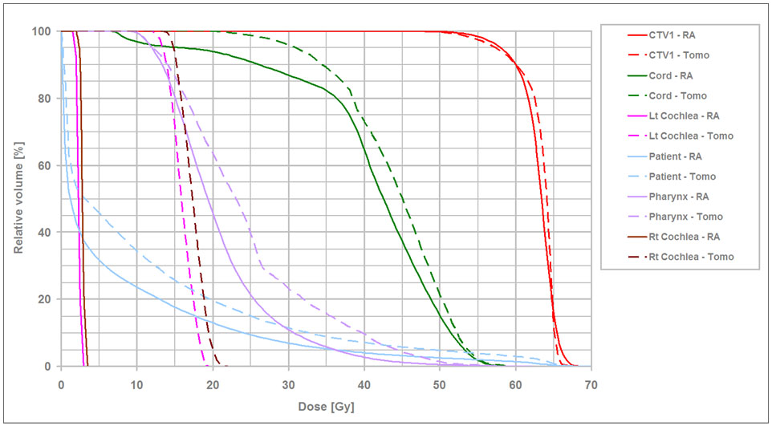
Dose-Volume Histogram (DVH)

Slide 14
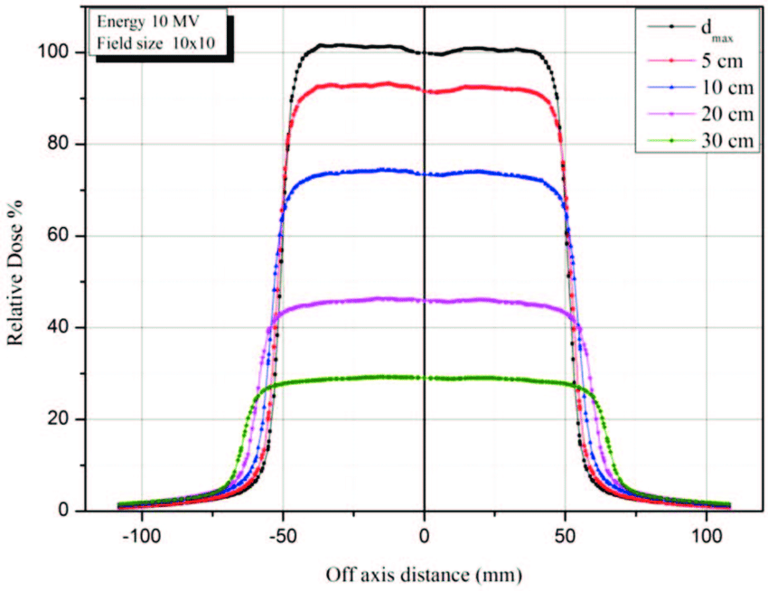
Beam Profile

Slide 15
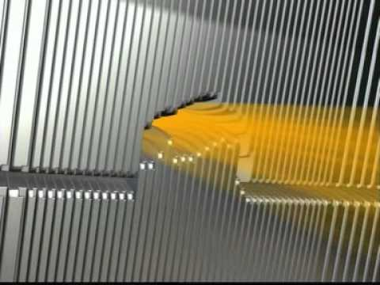
Multi-leaf Collimator (MLC)

Slide 16
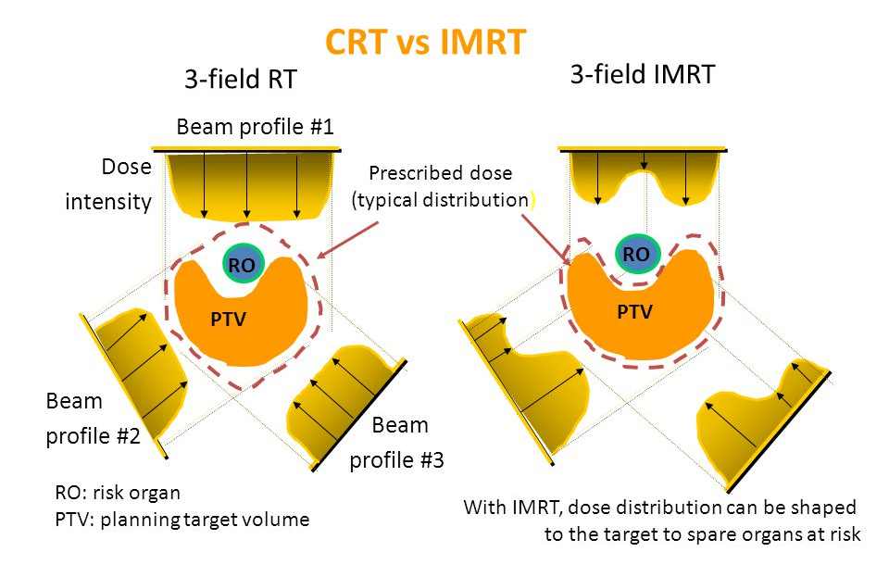

Slide 17
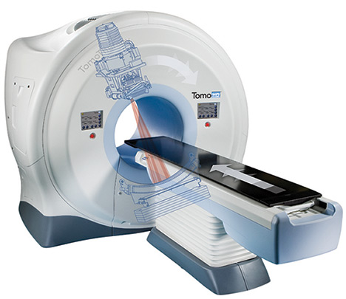
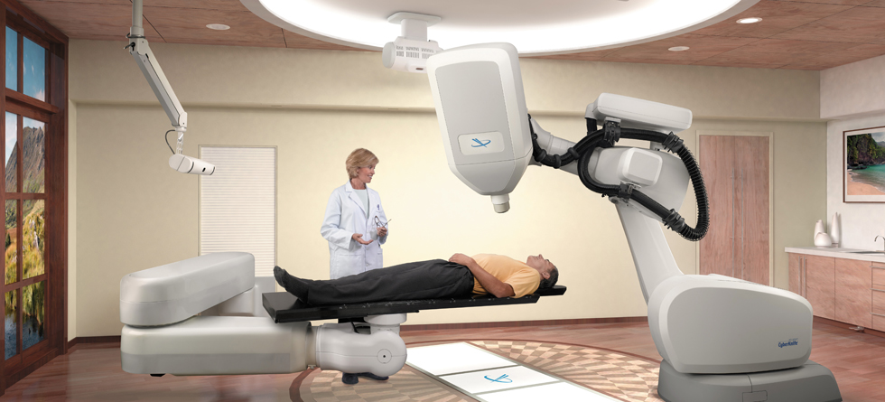
Approaches to IMRT
Step-and-shoot
Dynamic
Helical tomotherapy
CyberKnife

Slide 18
PROBABILITY OF TUMOR CONTROL
For subclinical disease (deposit of tumor cells too small to be detected clinically or even microscopically), doses of 45 to 50 Gy will result in disease control in more than 90% of patients. (CTV)
For clinically palpable tumors, doses of 65 to 80 Gy or even higher are required. (GTV)
A boost is an additional dose administered through small portals to residual disease; it is given to obtain a similar probability of control as for subclinical aggregates.

Slide 19
NORMAL TISSUE EFFECTS
The effects of irradiation are described based on the time in which they are observed: acute (first 6 months), subacute (second 6 months), or late.
Depending on their cellular architecture, organs are classified by functional subunits in either series (e.g., the spinal cord), in which injury of a segment results in a functional deficit of the distal organ, or parallel (e.g., lung, kidney), in which injury of a segment is compensated by function of unaffected adjacent segments.

Slide 20
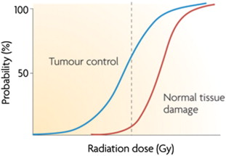
THERAPEUTIC RATIO (GAIN)
An optimal irradiation dose will produce maximal probability of tumor control with minimal frequency of complications.
The more the curves of tumor control probability and complication probability diverge, the more favorable the therapeutic ratio.

Slide 21
DOSE-TIME FACTORS
Fractionation of irradiation with prolongation of radiation course spares acute reactions because of compensatory proliferation of the acute responding tissues.
A prolonged course of therapy decreases early acute reactions but does not protect against serious late damage to normal tissue. In addition, it may allow the growth of rapidly proliferating tumors and may be inconvenient for the patient.
Late damage is dictated predominantly by radiation fraction size (rather than overall radiation course treatment time).

Slide 22
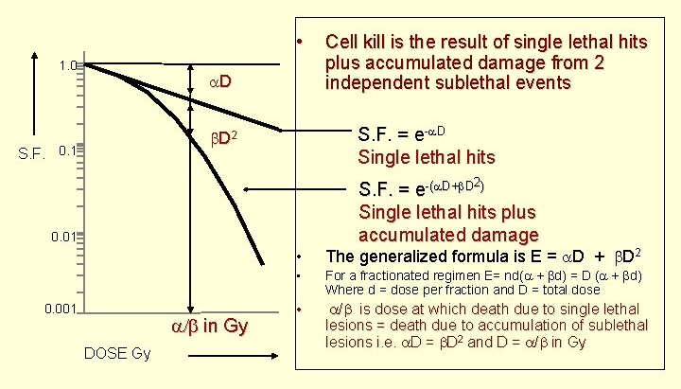
Linear-Quadratic Equation (α/β Ratio)

Slide 23
α/β Ratio
Acutely reacting tissues have a high α/β ratio (between 8 and 15 Gy), whereas tissues involved in late effects have a low α/β ratio (1 to 5 Gy).

Slide 24
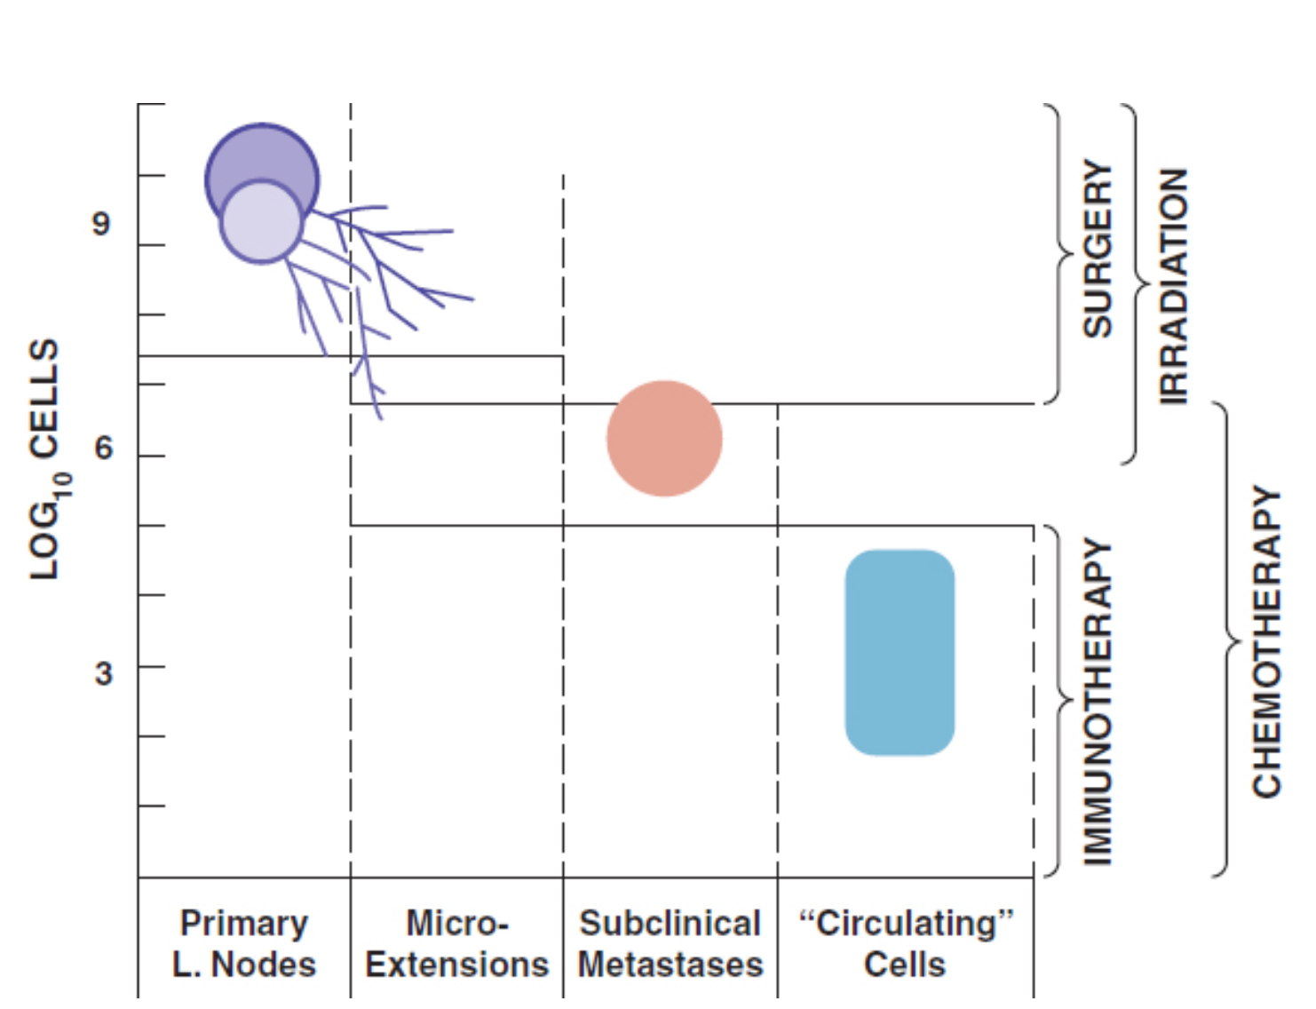
COMBINATION OF THERAPEUTIC MODALITIES
Preoperative Radiation Therapy
Postoperative Irradiation
Irradiation and Chemotherapy
  Primary chemotherapy
  Adjuvant chemotherapy
  Neoadjuvant chemotherapy
  Concurrent

